Slide 1
IML Progress Summary
Outline
Issue resolved with Forest Fire
Feature Selection
Model Selection

Slide 2
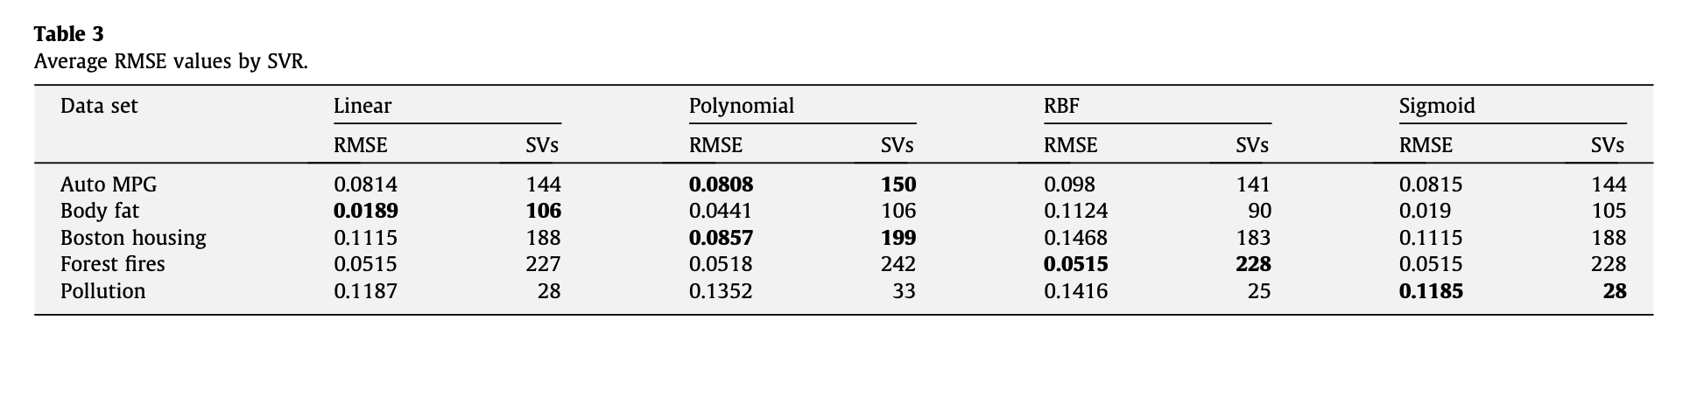
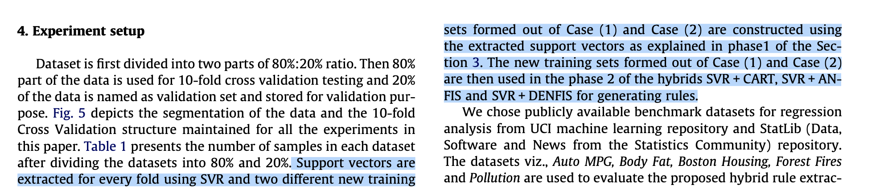
1. Issue resolved with Forest Fire

Slide 3
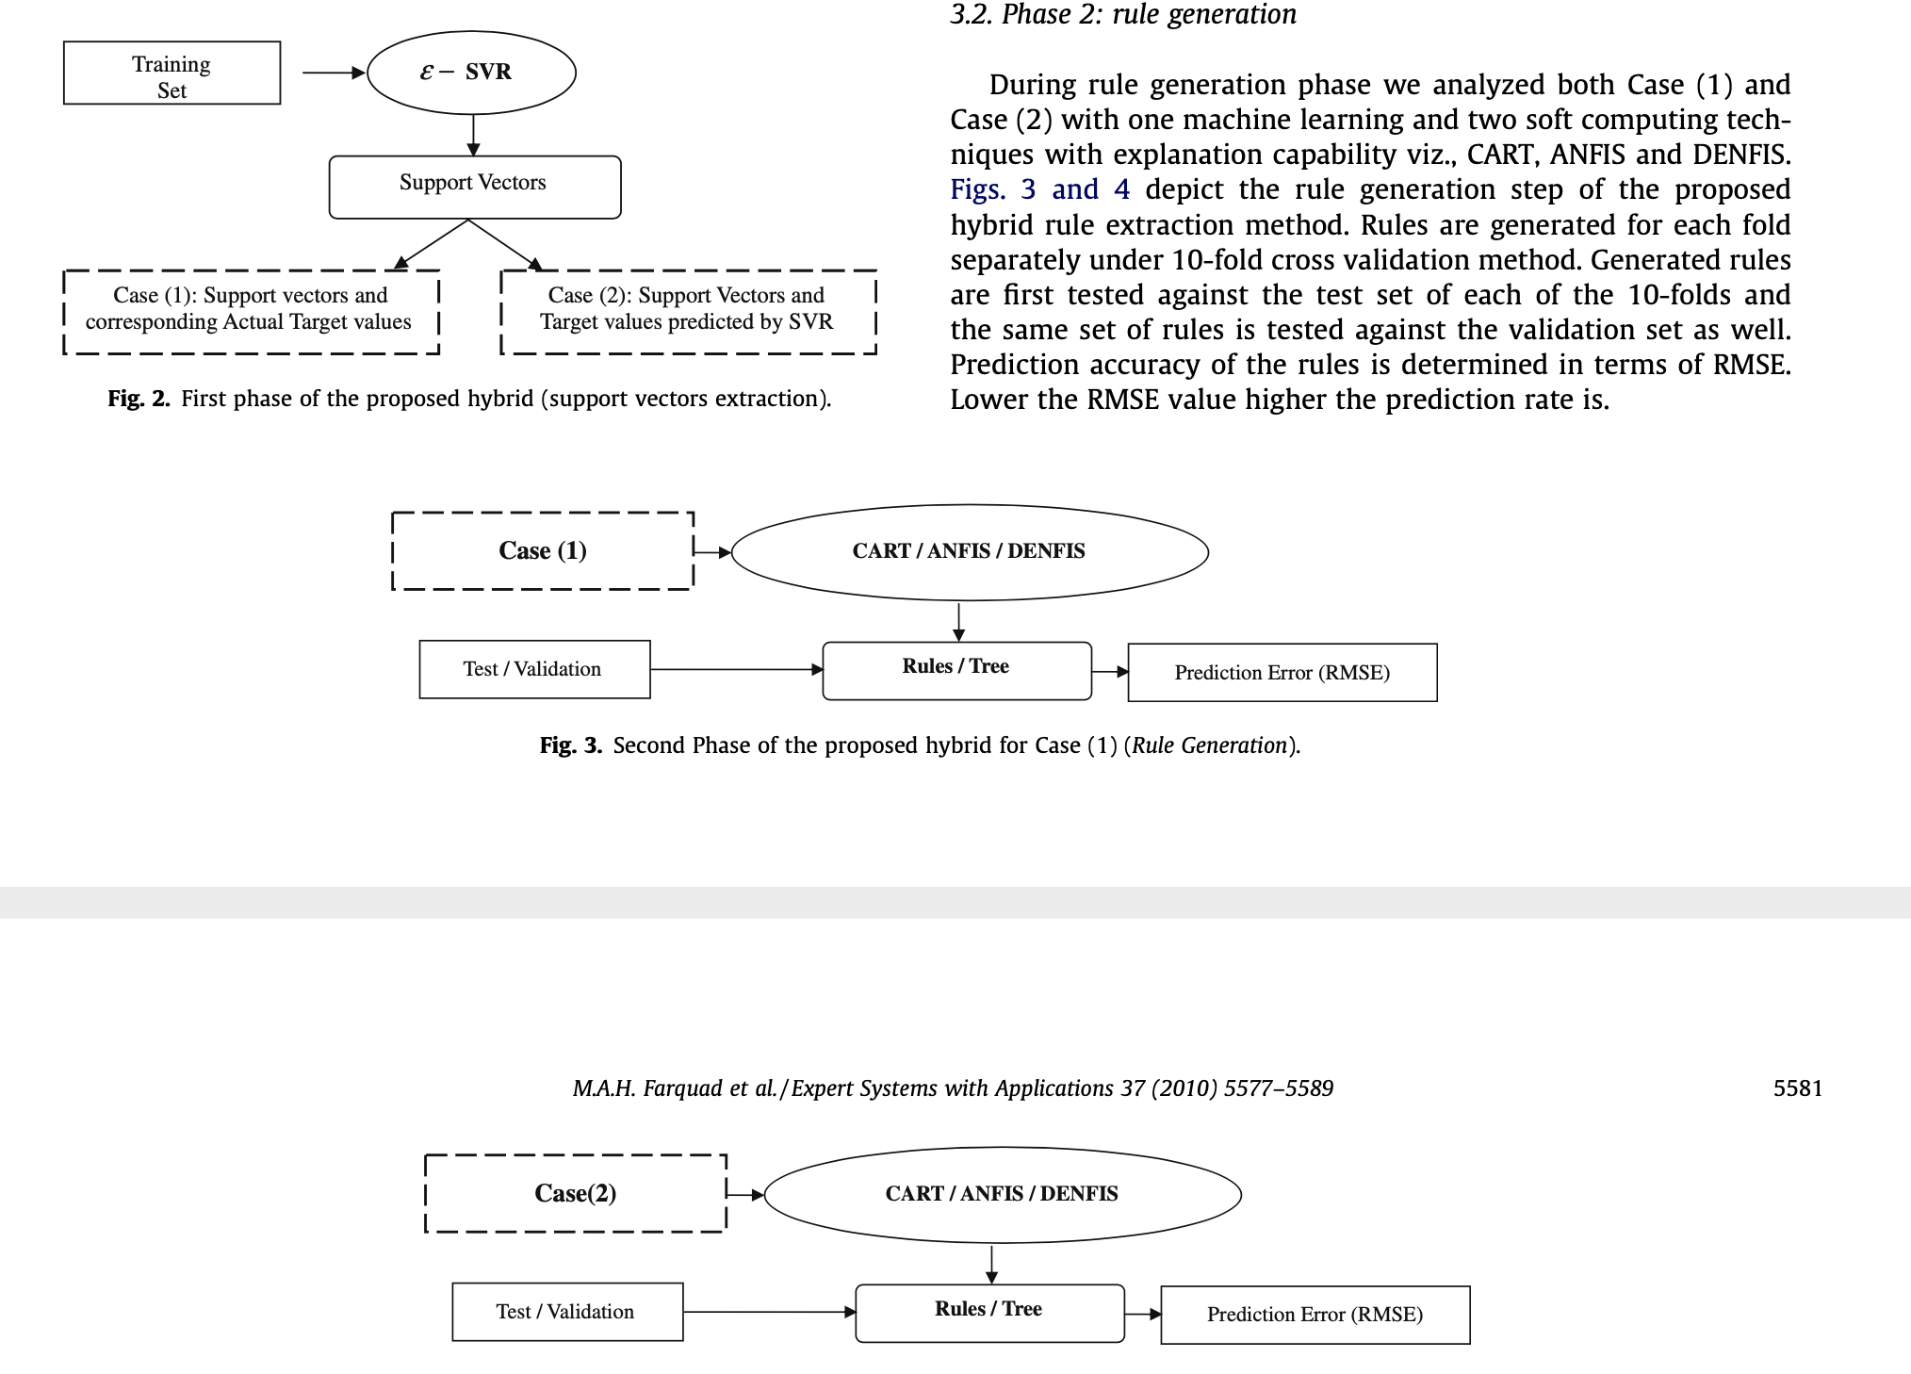

Slide 4
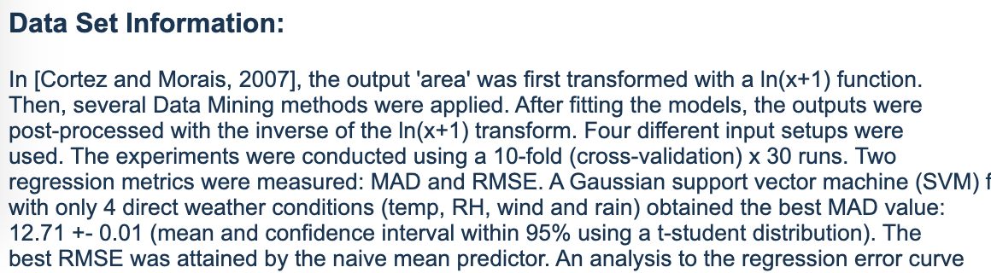
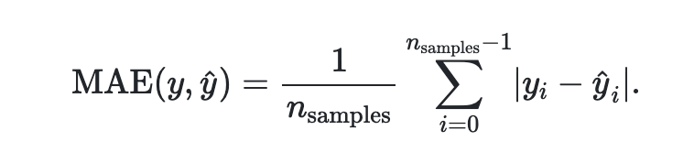
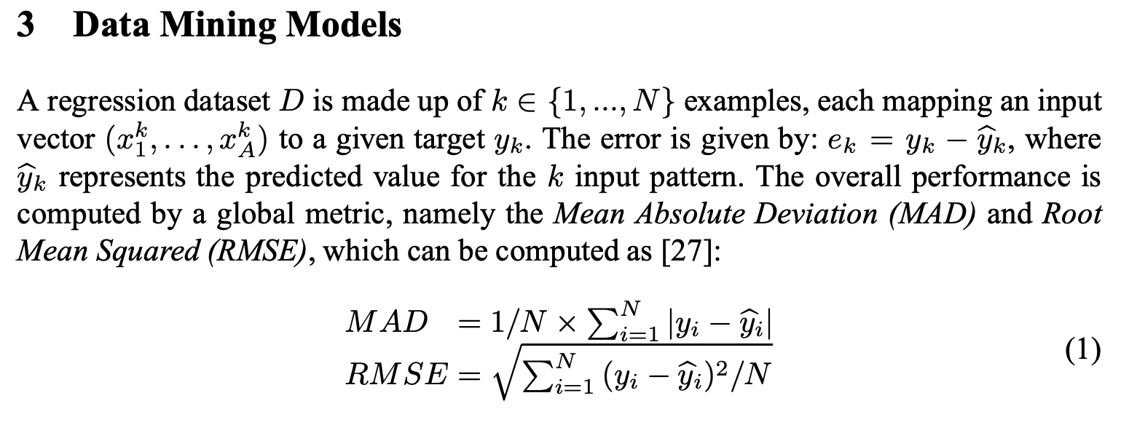
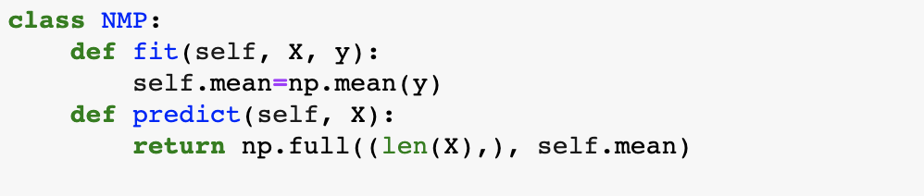
1.1 What is left:
Paper:
MSE: 4044.22
MAE (MAD): 12.71
Ours (SVR):
MSE: 14.77 , std: 16.56
MAE (MAD): 2.31, std: 1.52

Slide 5
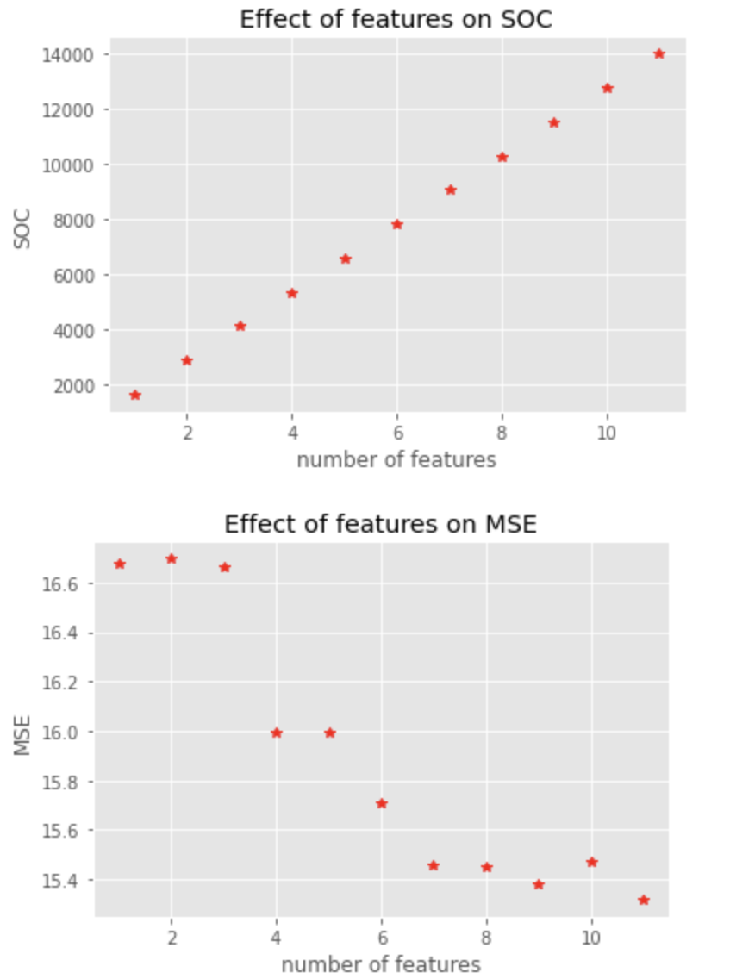
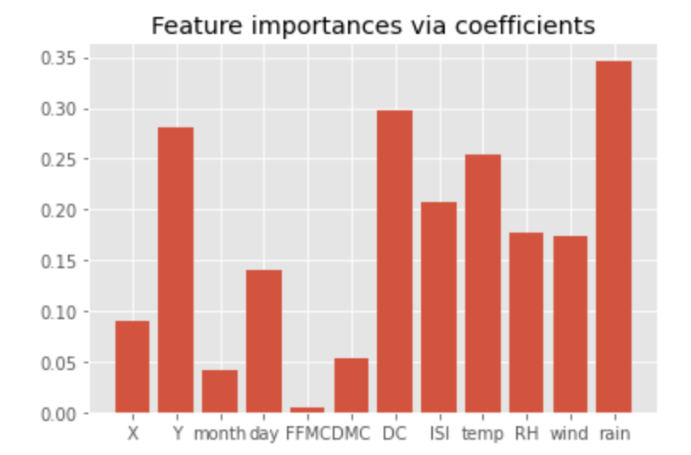
2. Feature Selection
SelectFromModel with LinearRegression

Slide 6
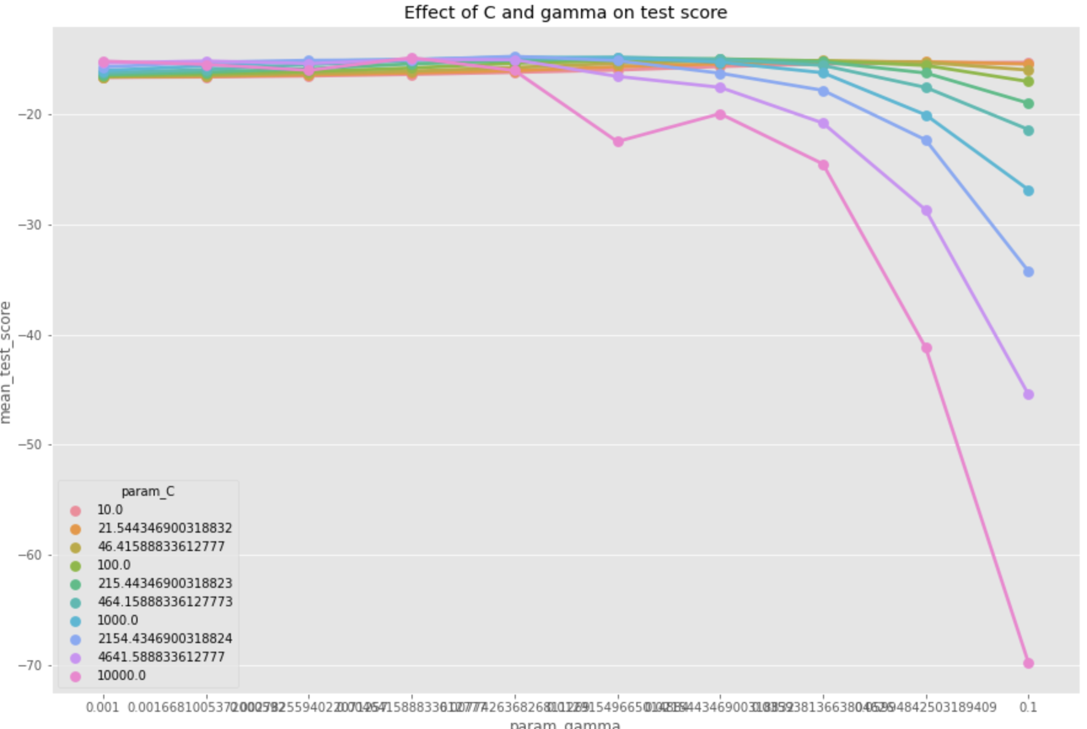
3. Model Selection. GridSearchCV

Slide 7
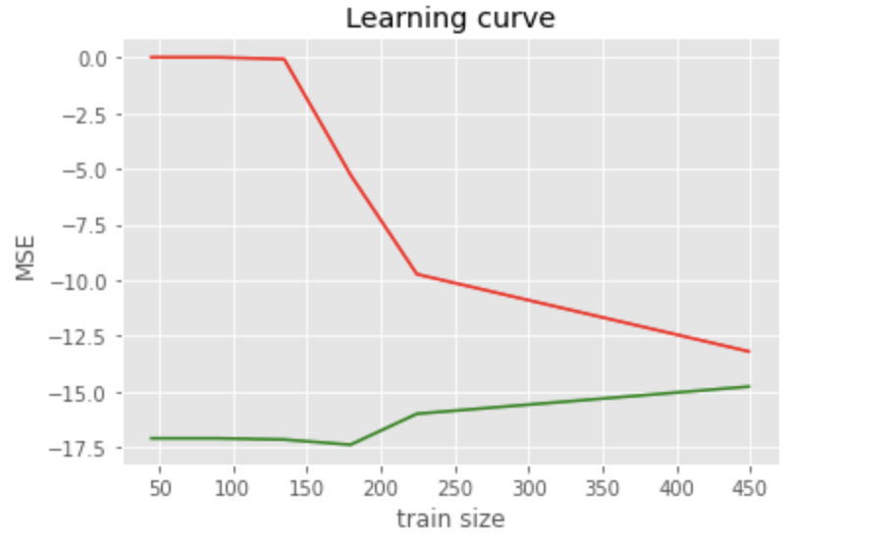
3. Model Selection. Learning Curve

Slide 8
3. Model Selection. Error
mse=cross_val_score(svr,X,y,cv=10,scoring='neg_mean_squared_error')
std=np.std(mse)
mse=np.abs(np.mean(mse))

Slide 9
References
Farquad, M. A. H., Ravi, V., Raju, S. B. (2010). Support vector regressionbased hybrid rule extraction methods for forecasting. Expert Systems withApplications, 37(8), 5577-5589.
Cortez, P., & Morais, A. D. J. R. (2007). A data mining approach to predict forest fires using meteorological data.
https://scikit-learn.org/stable/modules/model_evaluation.html#mean-absolute-error
Notebooks: https://drive.google.com/drive/folders/1A5Sxj0uMyn-I3adG5tO3O_KT4ET1QXwx?usp=sharing

